Slide 1

Minor Project
(CS64123)
Presented By: Group No 48 Supervised By:
1. Vikash Kumar(2206133) Jyoti Prakash Singh,
2. Gyan Ranjan Nayak(2206197) Associate Professor, CSE,
3. Shivani Saroj(2206251) NIT Patna

Slide 2
Project Title Depression Detection from Twitter Data Using BERT and LIME: An Explainable AI Approach

Slide 3

Table of content
Introduction
Related Work
Problem Statement
Objective
Proposed Model
About the Dataset
Working
Why BERT + LIME Model
Future Goal
Conclusion
References

Slide 4
Introduction
Depression is a common mental health disorder that affects millions of people worldwide.
According to WHO Report March 2023 An estimated 3.8% of the population experience depression, including 5% of adults (4% among men and 6% among women), and 5.7% of adults older than 60 years. More than 700 000 people die due to suicide every year. Suicide is the fourth leading cause of death in 15–29-year-olds.
Global Impact: Depression can lead to severe outcomes like reduced productivity, deteriorating mental and physical health, and, in some cases, suicide.
Why Early Detection is Important: Early detection can help prevent worsening symptoms by encouraging individuals to seek timely help.

Slide 5
RELATED WORK
Venkatasai Ojus Yenumulapalli, Viai Aravindh R, Rajalakshmi S, Angel Deborah S (2022) - BERT
Utilized the BERT-base-uncased model for depression analysis, fine-tuning it with labeled training data.
Incorporated a label encoder to convert target labels into numerical values for model compatibility.
Kayalvizhi and Thenmozhi (2022)
Developed a gold standard dataset to classify depression levels (moderate, severe, not depressed) using social media texts.
Applied data augmentation to address imbalance, using Word2Vec vectorizer and Random Forest classifier for improved accuracy.
Salas-Zarate et al. (2022)
Used Twitter as primary data source for depression sign detection, employing word embedding for linguistic extraction.
Implemented Support Vector Machine (SVM) for classification, with cross-validation (CV) to evaluate performance.

Slide 6
Problem Statement
All the models mention above have a major problem that they only classify the tweets into depression and non-depression class but they don’t provide supporting words or reasons why their model classify a specific tweet in two different class (depression & non-depression). All the models are like black box model.
Detecting depression through text analysis is challenging due to:
Subtle emotional expressions and nuanced language (e.g., sarcasm, hidden sadness).
Lack of transparency in AI models, which often behave like "black boxes.“
Problem: How can we design an advanced machine learning model that reliably identifies signs of depression in user tweets, delivering transparent and interpretable explanations for its predictions to empower mental health interventions and support systems?

Slide 7
Objective
To develop an explainable machine learning model that can:
Detect depressive tendencies from stream of users Tweets using BERT.
Explain the key phrases that led to the classification using LIME to Increased Trust in AI

Slide 8
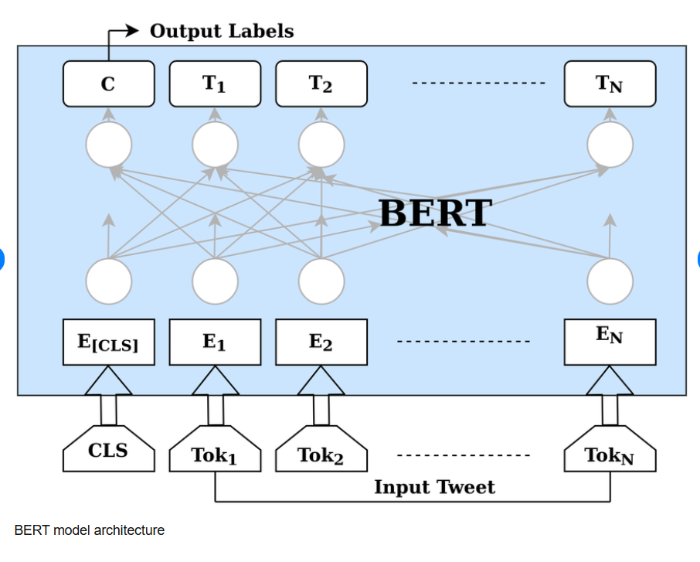
Proposed Model
BERT (Bidirectional Encoder Representations from Transformers)
machine learning framework for NLP
developed by google in 2018
two step process-:
Pre training on Large Amount of unlabelled text (MLM , NSP)
Fine-tuning on labelled data

Slide 9
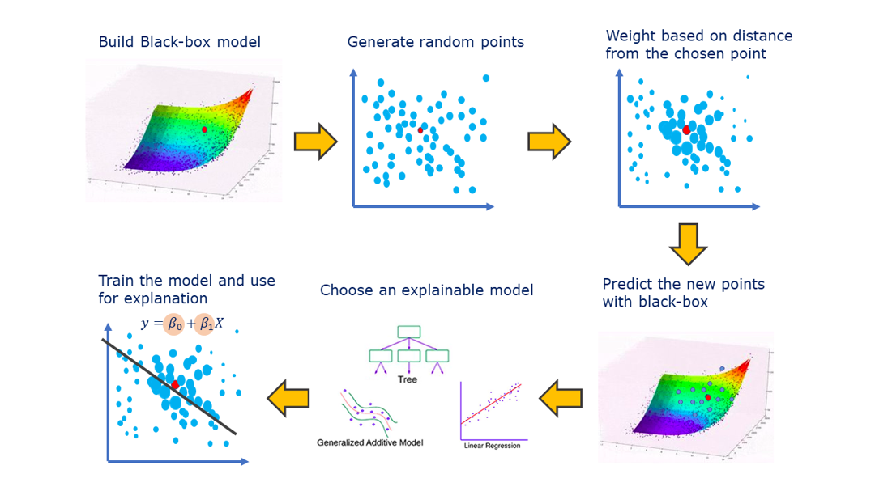
Proposed Model Continue…
LIME (Local Interpretable Model-agnostic Explanations)
used to explain the predictions made by any black-box classifier.
Steps:
Perturbing the sample
Labelling the Perturbed samples
Weighting
Learning the Interpretable Model

Slide 10
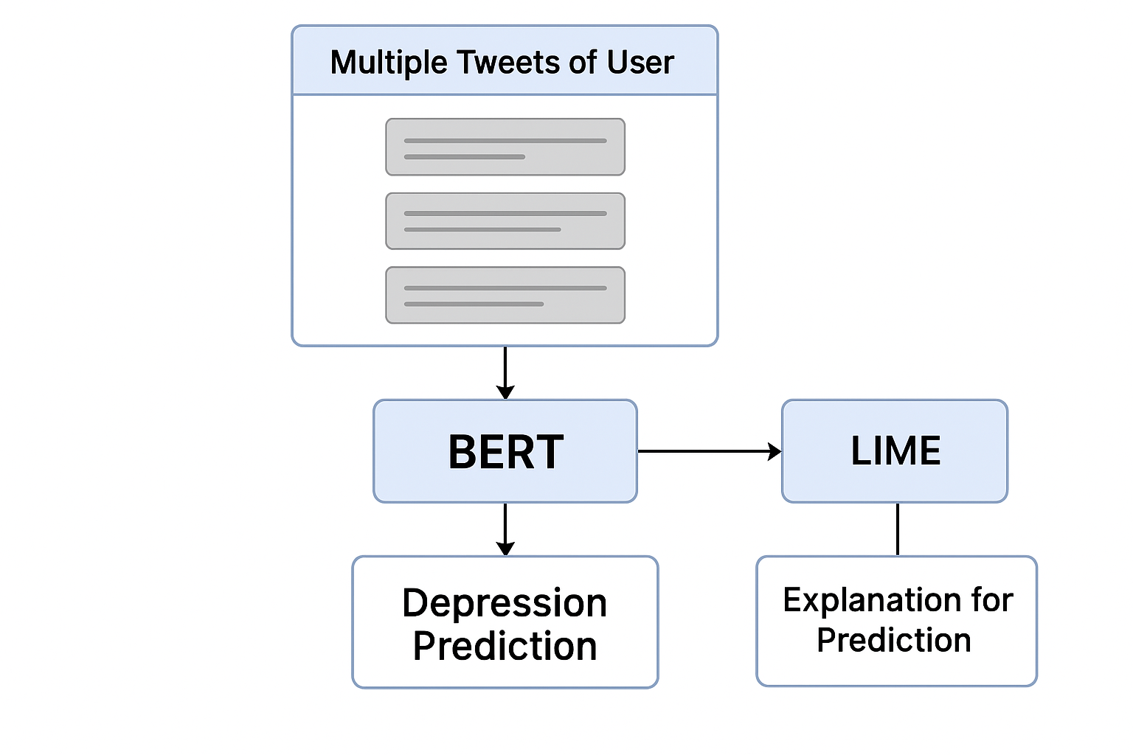
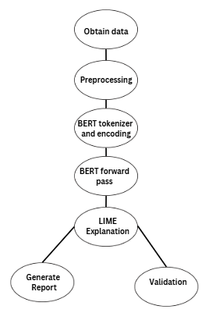
Proposed Model Continue…

Slide 11

About The dataset Used
For the training, we are using Real Tweets of 410 users consisting of depression and non depression class and 15 tweets of each user.
In the depression class, we have 205 rows.
In the non depression dataset we have 205 rows
The dataset contains labels as -
- user_id
- Tweet
- Status(depression, normal)

Slide 12
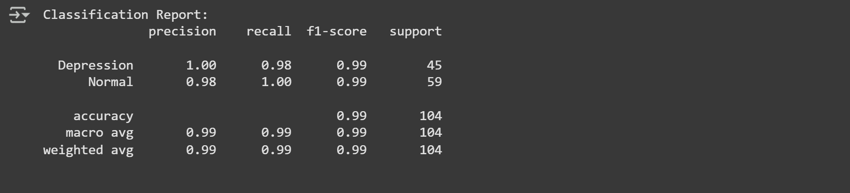
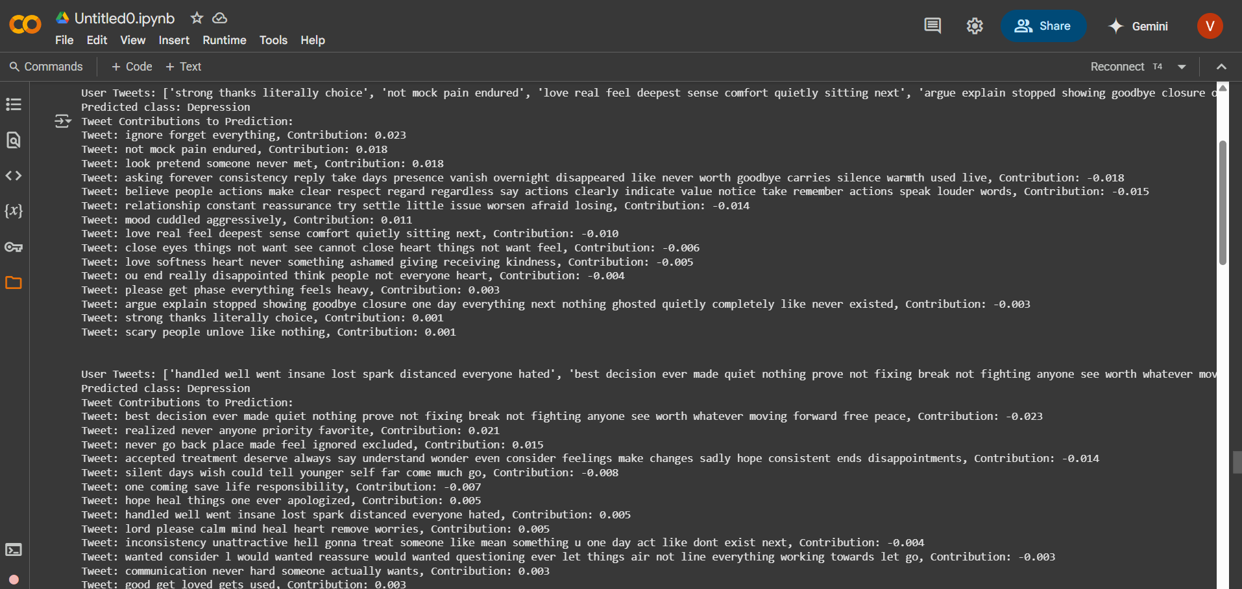
Working
Confusion matrix
Output generated by BERT on multiple Tweets of an user

Slide 13
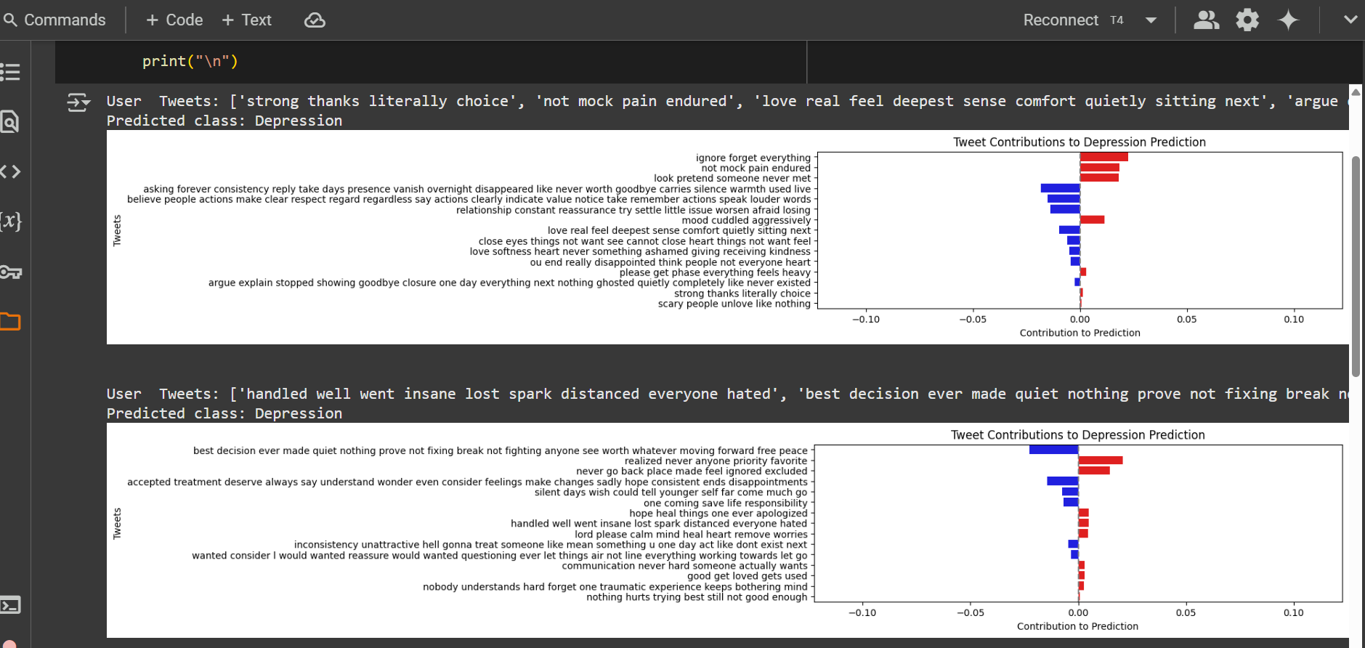
Working (Continue…)
Output generated by BERT + LIME on multiple Tweets of an user

Slide 14
Why Bert + Lime Model?
Advanced Contextual Analysis and High Accuracy BERT’s bidirectional design captures tweet emotions (e.g., sarcasm), outperforming TF-IDF or LSTM for accurate depression detection in Training.csv.
Clear and Transparent Explanations LIME highlights key words (e.g., “sad”) in red, simplifying BERT’s predictions for mental health use, unlike complex SHAP.
Strongly work with Limited Data BERT excels with the 516-sample dataset via pretraining, and LIME enables case-specific analysis, surpassing data-intensive GRUs.
Ethical and Trustworthy BERT reduces missed detections, and LIME’s visualizations ensure transparency, meeting responsible mental health screening needs.

Slide 15
Future Goal
1. Multilingual Support
Expand the model to multilingual datasets while ensuring bias-free predictions
2. Improve Explainability
Advance LIME visualizations with interactive dashboards, highlighting key phrases for clinicians, making predictions more actionable than current word-level outputs.
3. Real-Time Deployment
Develop a Flask API for real-time tweet analysis, integrating with social media platforms to flag at-risk users instantly for timely interventions.

Slide 16
CONCLUSION
Summary:
The BERT + LIME model effectively detects depression from text and explains the reasoning behind its predictions.
This combination improves both accuracy and trust, making it useful for real-world applications.
Key Takeaway:
The model could play a crucial role in early depression detection and mental health support.

Slide 17
Reference
https://aclanthology.org/2023.ltedi-1.22.pdf
https://www.researchgate.net/publication/359904922_Feature_Based_Depression_Detection_from_Twitter_Dat a_Using_Machine_Learning_Techniques

Slide 18
THANK YOU

